Slide 1


VaultIQ — Private AI
Securely build an isolated, searchable enterprise knowledge base directly from your own business documents and files.

Slide 2

Isolated & Secure Enterprise Knowledge
Your Data, Completely Isolated
Automatic Syncing: Monitors local folders, network drives (NAS), and cloud drives natively in the background.
Secure Indexing: Encrypts and processes files securely in the cloud to guarantee corporate data isolation.
Strict Truthfulness: RAG engine answers are grounded strictly in your DataSets with zero public AI hallucinations.

Slide 3
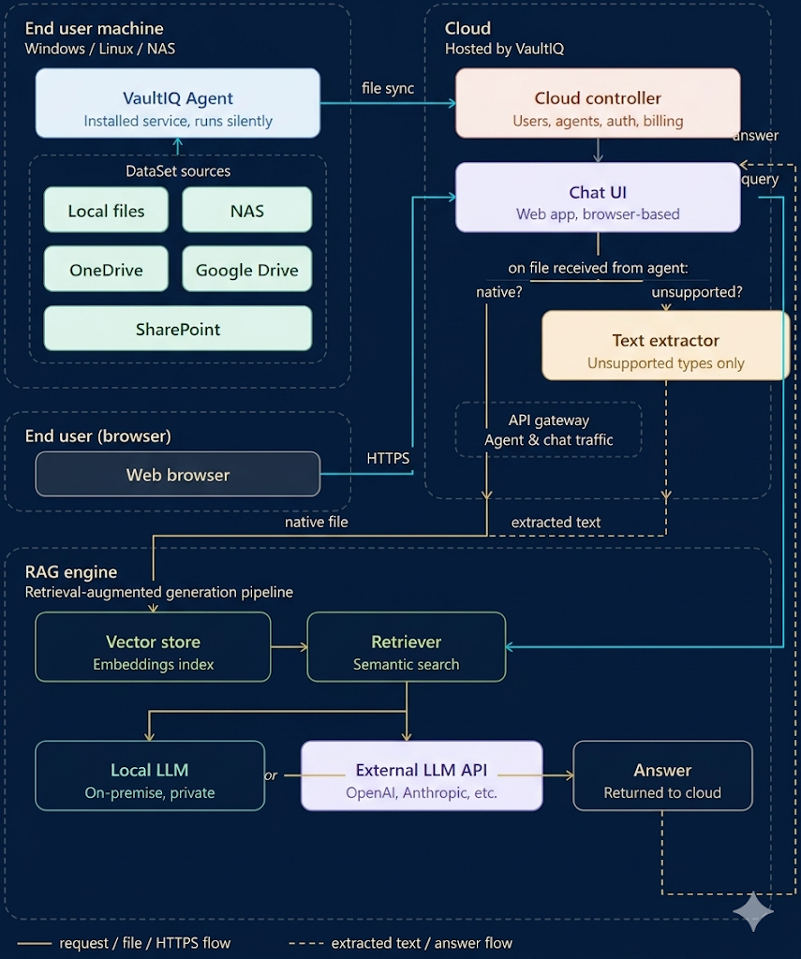
System Architecture
Seamless Core Data Pipeline
VaultIQ pairs a silent, lightweight background sync agent with a powerful SaaS cloud pipeline and local RAG search indexer.
All data traffic relies on strict encrypted TLS paths, and files run through automated pipelines to isolate vectors cleanly based on unique secure DataSet boundaries.

Slide 4







VaultIQ Cloud
Identity & Access
Ingestion Pipeline
Query Routing
Enforces zero-trust isolation boundaries. Users can strictly query their assigned DataSets with verified session keys.
Natively routes supported file types directly into vectors. Non-native documents are pre-routed for safe text extraction first.
Safely handles queries via the RAG API. Verifies access bounds, queries target vectors, and feeds scoped context safely.

Slide 5


VaultIQ Agent
Edge Synchronization
Resilience & Data Purge
A native, silent service engineered to securely monitor storage assets locally without requiring user active sessions.
Engineered for high-availability scenarios to preserve database integrity and state during connection dropouts.
Installs easily as Windows Service or Linux systemd daemon.
Maintains disk-persistent queues to withstand system reboots.
Schedules silent background sweeps for NAS, local folders, or cloud drives.
Employs AES-256 local compression and secure SSL tunneling.
Issues tombstone signals instantly for deleted items to purge vectors.
Automates failover retries using reliable exponential backoff logic.

Slide 6
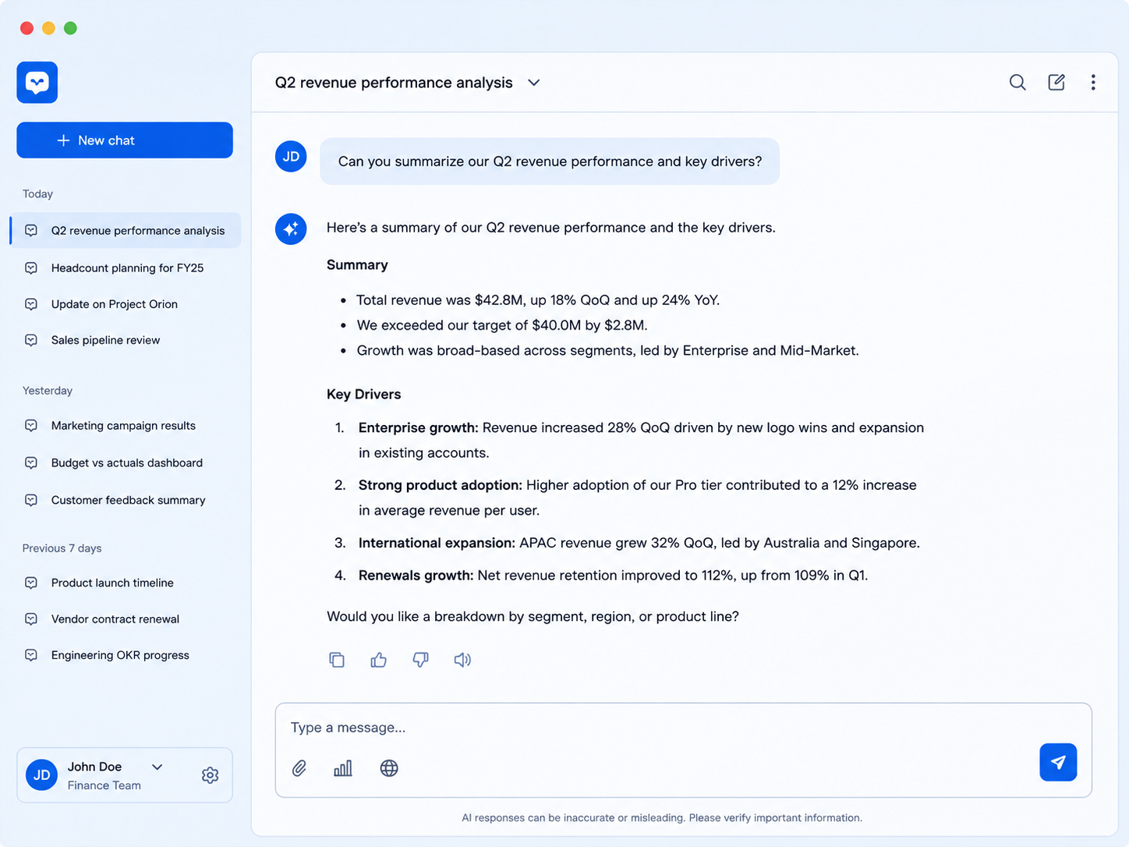
VaultIQ Chat
Immediate Grounded Answers
Direct Citations: Displays verifiable source document names and exact target segments next to every generated text block.
Flexible LLM Engine: Toggle easily between top third-party LLMs (OpenAI, Anthropic, Mistral) or a secure, private, local LLM option.
Context Persistence: Organizes past user chats cleanly in a secure conversation history panel.

Slide 7


Zero Trust Data Isolation
Engineered for B2B Security
Unlike consumer AI wrappers, VaultIQ ensures that your enterprise knowledge base stays completely quarantined inside your unique cloud instance.
Your documents are never used for public training, and all access is governed strictly by organizational context limits.
PRIVATE & SECURED

Slide 8







Vaults, DataSets & User Roles
One business · Multiple Vaults · Four role types
VAULT & DATASET MODEL
USER ROLES
🏢 Your Business
Admin
Create/manage Vaults · Invite users · Assign roles · Control Vault visibility for all users
Multiple Vaults
Vault A
HR & Legal
Vault B
Finance
Vault C
Projects
Vault Admin
each Vault contains one or more DataSets
Manage Vaults · Install Agent & create DataSets on any machine · Assign DataSets to Vaults
DS:
Contracts
DS:
Policies
DS:
Invoices
DS:
Reports
Vault Contributor
★ A DataSet can belong to more than one Vault
Install Agent & create DataSets on own machine · Assign DataSets to Vaults · Chat in assigned Vaults
Vault Viewer
Chat and ask questions only · Access only Vaults assigned by Admin · Cannot add files or create DataSets
Admin controls which Vaults each role can access.

Slide 9
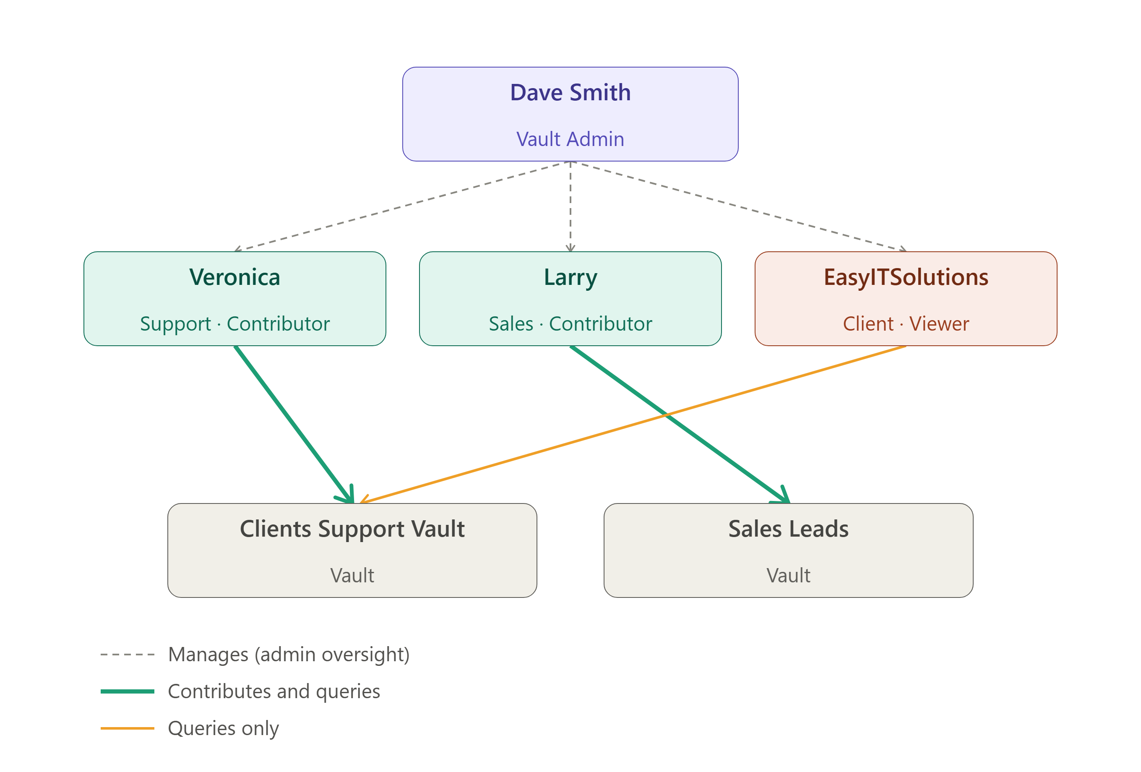
Vaults, DataSets & User Roles
A practical demo:
Dave Smith sits at the top as Vault Admin — the dashed lines show his oversight of Veronica, Larry, and EasyITSolutions. As Admin, he also has full authority over both vaults directly.
Veronica and Larry each get a solid teal line to their own vault — same access pattern (contribute + query), just pointed at different vaults.
EasyITSolutions gets a thinner amber line to Clients Support Vault only —his relationship is read-only, and notably there's no line at all to Sales Leads, since that vault is completely outside their access.

